Slide 1

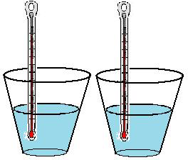
Specific Heat Capacity Experiment Year 11 ATAR Physis
This Photo by Unknown Author is licensed under CC BY-SA
Mrs Martin

Slide 2
What is the absolute temperature scale?
Which of the following converts to degrees?
_________ + 273.15 = _________
_________ - 273.15 = _________

Slide 3
Definitions from previous lesson
Thermal energy – the total kinetic and potential energy in a substance
Temperature – measure of the average kinetic energy of the particles in a substance
Heat – transfer of thermal energy from one substance to another due to a difference in temperatures
Thermal equilibrium – when two objects have the same temperature
Notes:
Sound is a longitudinal wave of vibrating particles (back and forth)

Slide 4
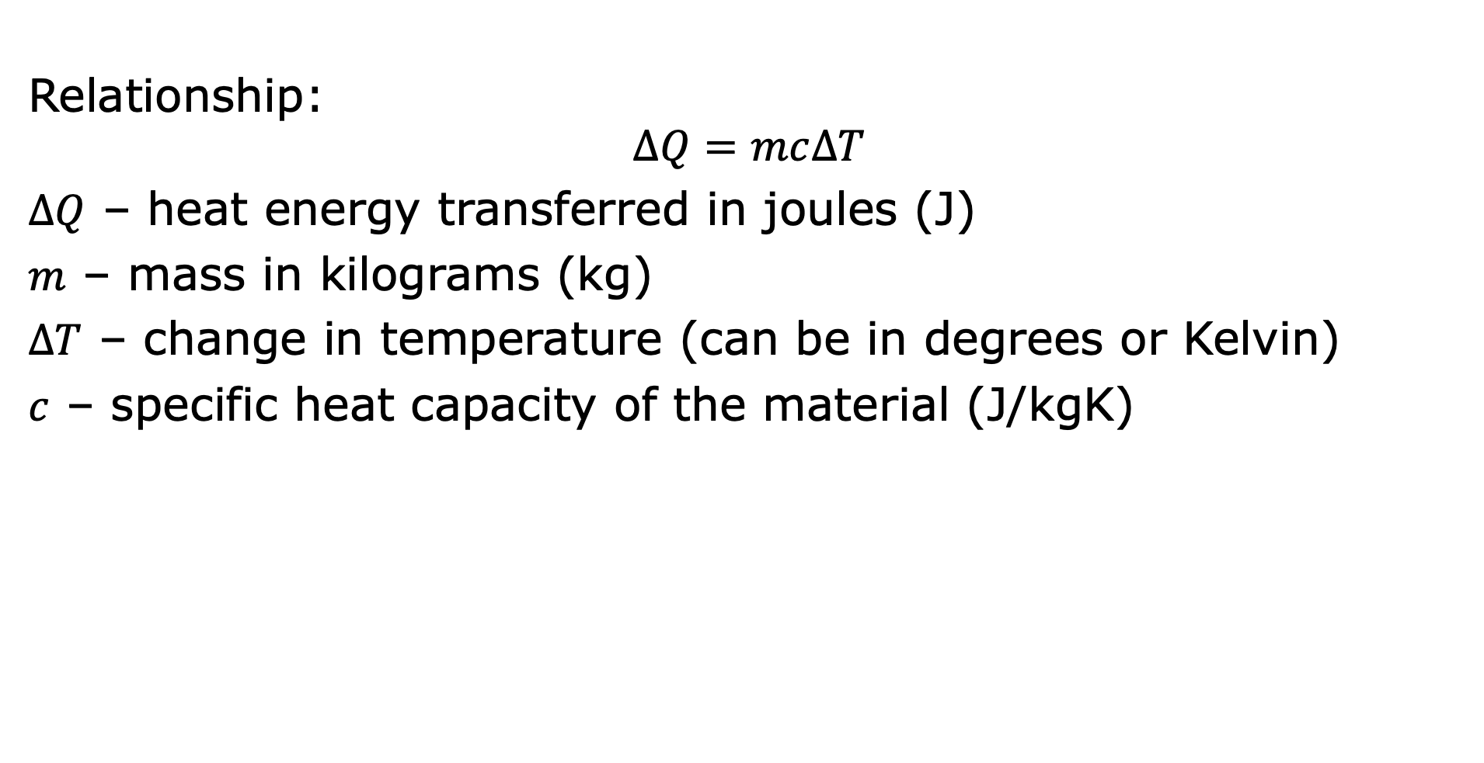
Specific heat capacity
Relationship:
$$∆Q=mc∆T$$
$∆Q$ – heat energy transferred in joules (J)
$m$ – mass in kilograms (kg)
$∆T$ – change in temperature (can be in degrees or Kelvin)
$c$ – specific heat capacity of the material (J/kgK)
Notes:
Sound is a longitudinal wave of vibrating particles (back and forth)

Slide 5
Specific heat capacity
A pot is filled with 9kg of water at 10K. Calculate how much heat energy would be needed to raise the temperature to 60K.
Notes:
Sound is a longitudinal wave of vibrating particles (back and forth)

Slide 7
Outline of the experiment
Two beakers of equal mass will be placed on the hot plate.
Beaker one will contain salt water, beaker 2 will contain water.
The temperatures of the two different substances are taken at the beginning of the experiment and measured every 2 minutes after that till one of the substances boils.
Notes:
Teacher Cue – refer to the vocabulary box as you read through and “unpack” the definition provided. Use hand gestures to emphasise the ”2 or more”, “mixed” and “separated” parts of the definition.
Have students complete CFU 1 as a pair-share, then record these definitions & examples as notes (with diagrams) if desired.
CFU 2 – pair-share, then whiteboards for answers – call on non-volunteers.

Slide 8
Planning and Conducting
Develops a clear hypothesis which relates the independent and dependent variables Lists all materials required Identifies controlled variables
Clearly lists the procedure/method to be used clearly describes equipment and how it is set up describes how trials are to be conducted in a clear logical manner description of method allows for investigation to be repeated by others states which measurements are to be collected plans for repeat trials
Shows a labelled diagram Collects full and accurate results Displays data in suitable table
Processing
Calculates the change in temperature for both substances. Calculates the energy required for the liquids to heat up.
Displays data in suitable graph title labelled axes with units data correctly plotted
Calculates the energy absorbed by each of the substances. Calculates percentage uncertainty States a conclusion and relates it to the hypothesis
Evaluation
Discusses sources of error or uncertainty in the data Makes reasonable suggestions for improvements to procedure
Aspects of scientific report
Notes:
Teacher Cue – refer to the vocabulary box as you read through and “unpack” the definition provided. Use hand gestures to emphasise the ”2 or more”, “mixed” and “separated” parts of the definition.
Have students complete CFU 1 as a pair-share, then record these definitions & examples as notes (with diagrams) if desired.
CFU 2 – pair-share, then whiteboards for answers – call on non-volunteers.

Slide 9

Notes:
Teacher Cue – refer to the vocabulary box as you read through and “unpack” the definition provided. Use hand gestures to emphasise the ”2 or more”, “mixed” and “separated” parts of the definition.
Have students complete CFU 1 as a pair-share, then record these definitions & examples as notes (with diagrams) if desired.
CFU 2 – pair-share, then whiteboards for answers – call on non-volunteers.

Slide 10
Uncertainty calculations
 | Absolute uncertainty | Relative uncertainty
Mass
Temperature
Notes:
Teacher Cue – refer to the vocabulary box as you read through and “unpack” the definition provided. Use hand gestures to emphasise the ”2 or more”, “mixed” and “separated” parts of the definition.
Have students complete CFU 1 as a pair-share, then record these definitions & examples as notes (with diagrams) if desired.
CFU 2 – pair-share, then whiteboards for answers – call on non-volunteers.

